Slide 1
TABLEAU PRESENTATION
By Chahak Nigam
DA/DS 21

Slide 2
OBJECTIVE
Football is one of the most loved game around the word . Every 4 years FIFA world cup is played between many countries .
The past years analysis of this championship can be very helpful as it helps us know about the past and predict the future of the same. In our table we have the records of this championship from 1930 to 2014
This data is useful for designing strategies, deciding the fare of tickets and for the stakeholders to accordingly invest the money
We may also use this data to compare the performance of various countries or a country’s present performance with its past etc.

Slide 3
ACKNOWLEDGEMENT
I would like to extend my heartfelt thanks to all the people how helped me complete my presentation. Firstly I would like to thank vice principal Dr. Ashish sir for giving me this opportunity to make this presentation . I would also like to thank my teacher Mr. Aryan Vijayvargiya for being my guiding light and would his support this could not have been possible.

Slide 4
index
SR. NO. | TOPIC
1 | Introduction to tableau
2 | Introduction to table
3 | Charts
4 | Story telling
5 | Dashboard
6 | Excel statistics

Slide 5
Introduction to tableau
Tableau is a data visualization tool used to create interactive shareable dashboards. It can connect to various data sources and hence is widely used
In essence pictures helps us understand the data easily . It also makes the work more interesting and easy to summarize.
It helps us gain insights which we may not understand my simply looking at the raw data.
It is used in industries such as data analytics , business intelligence etc.

Slide 6
Introduction to table
This is a data from Pro football reference.
This data thoroughly explains the FIFA world cup matched played from 1930-2014
This data has various columns like year, country , stadium, home and away team , stage, goals, attendance ,referee etc.
This data has over 800 rows

Slide 7
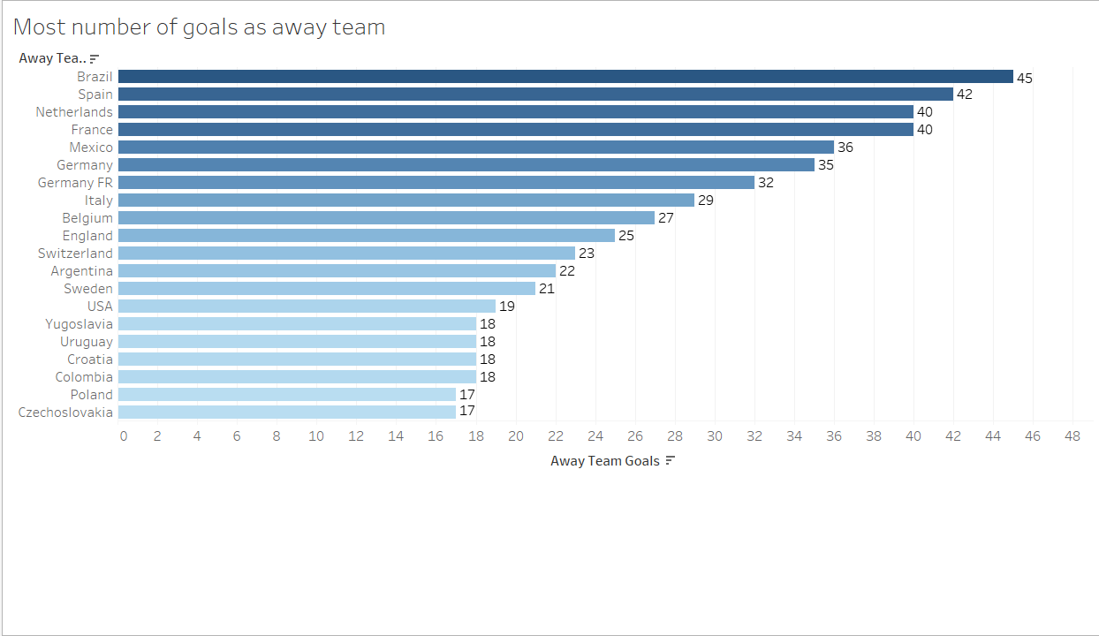

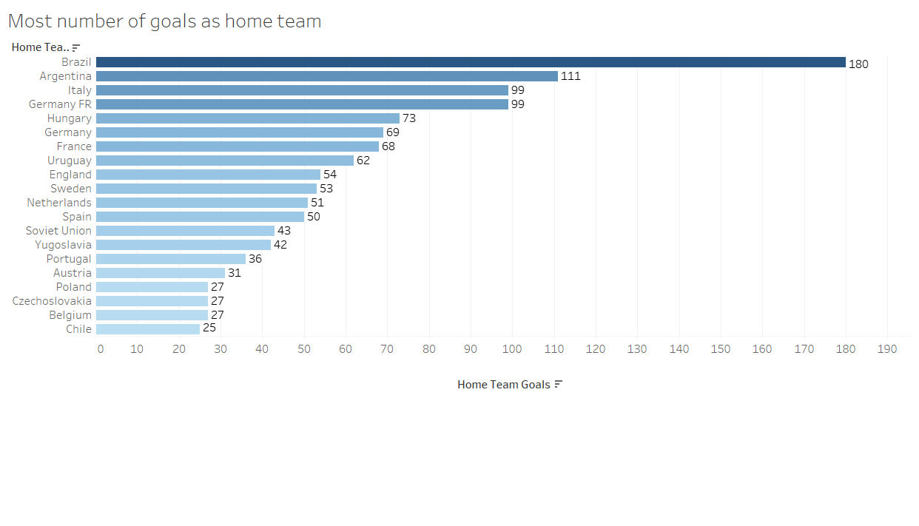

Column Charts
A bar graph is widely used for comparative analysis
The graph shown here is a horizontal bar graph
The graph shows the name of countries in rows and the number of goals scored in columns
In the first graph the country is playing as away country (the country which does not play at its own ground) and the second graph shows the scores when the country plays as home country
From both graph it can be said that a country performs better when it plays as the home country
Two parameters are given to adjust the number of countries to be displayed

Slide 8
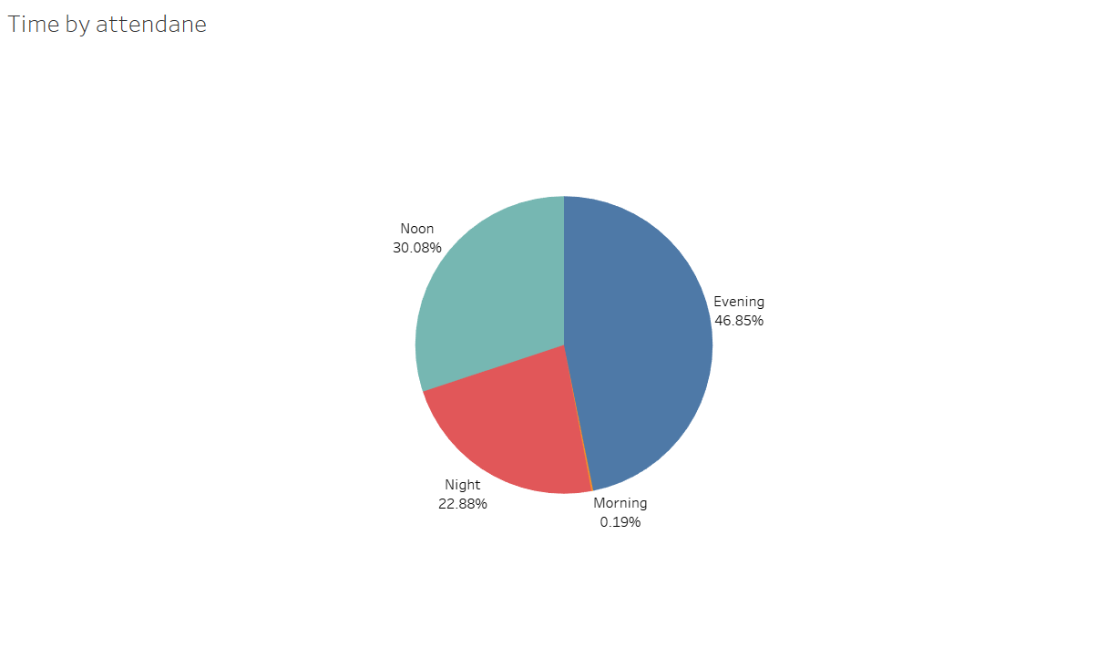
Pie chart
A pie chart is used for composition analysis
In our table we have four time classifications which are morning ,noon , evening and night
According to that we can see the number of people who have came to see the match
We may use this information to increase the price of the evening time to gain profit or can also decrease the price of morning match tickets to get more audience

Slide 9
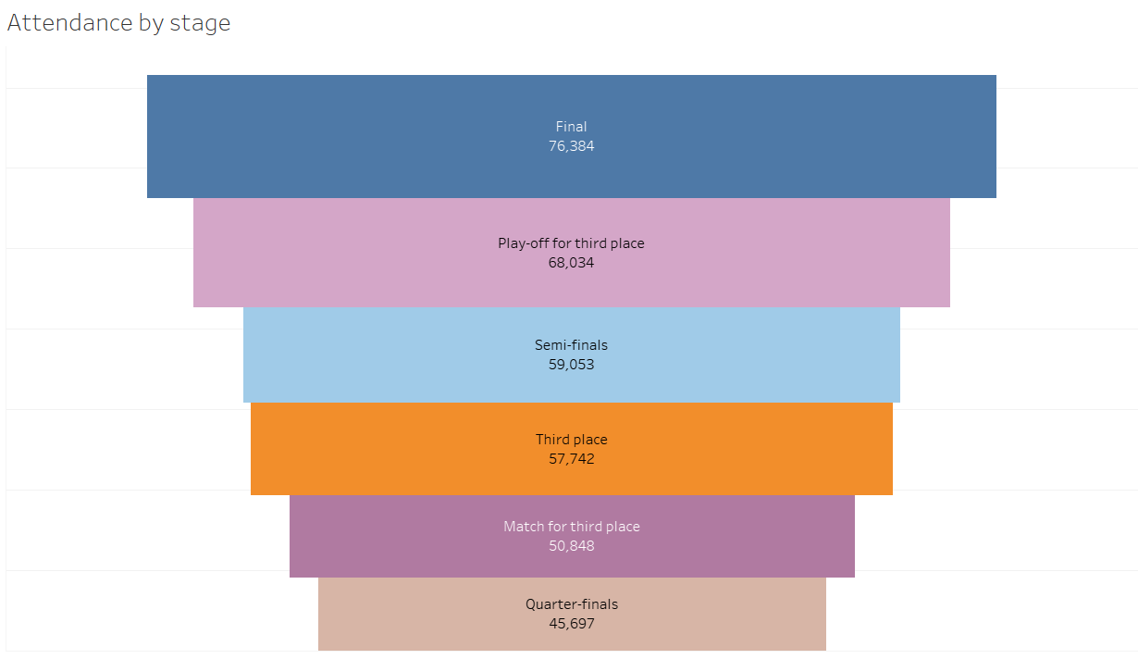
Funnel chart
A funnel chat is used to represent the progression that occurs at each step of a process
In tableau there is not an option of funnel chat
This chart is created by using stage name in rows and the attendance in size and lastly sorting it in decreasing order
This chart shows the stage vice attendance of each match
And as expected the finals have the most number of audince

Slide 10
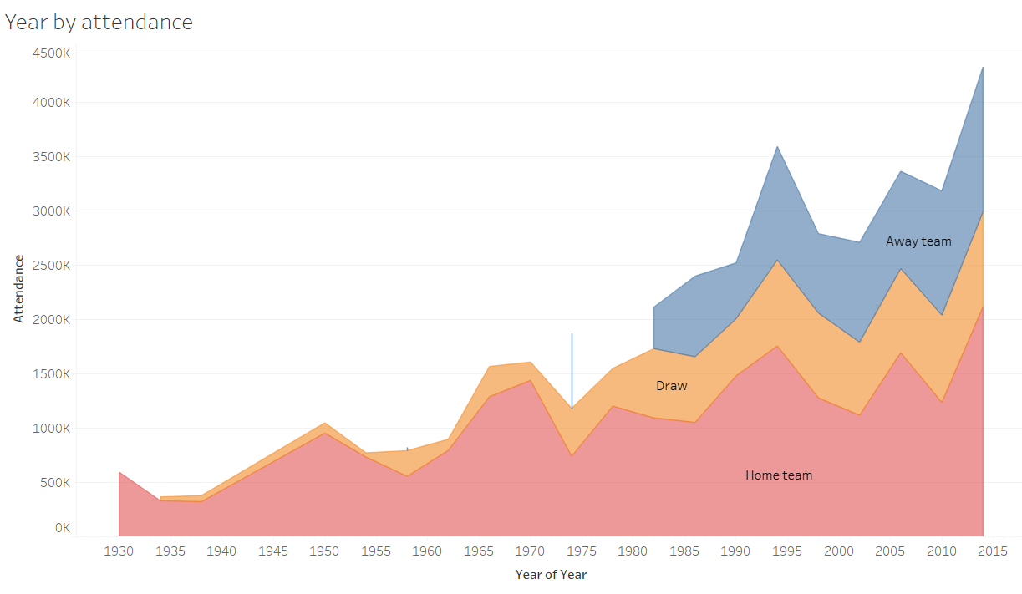
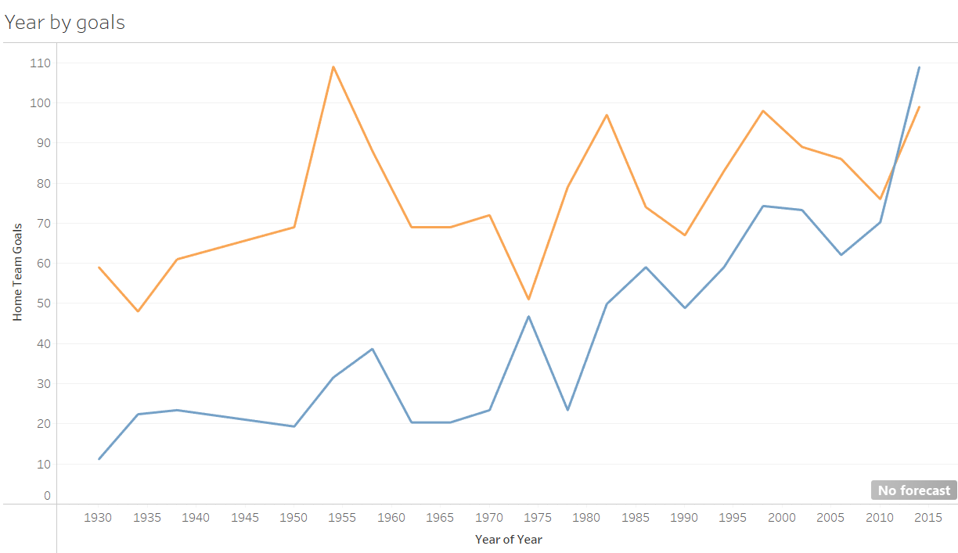
Area and line charts
The area and line charts are used to show the variation of one or more quantity with respect to time
The first graph is an area chart which shows the year vice increase in attendance, it is also divided on the basis of winning team category . We can see the gradual increase of audience over years
The second graph is a line chart which shows the increase in goals year vice . The yellow line shows the home team goals and blue line shows the away team goals . The graph shows that in the starting years home team made more goals but now the away team has caught up

Slide 11
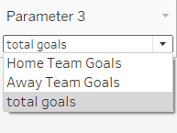
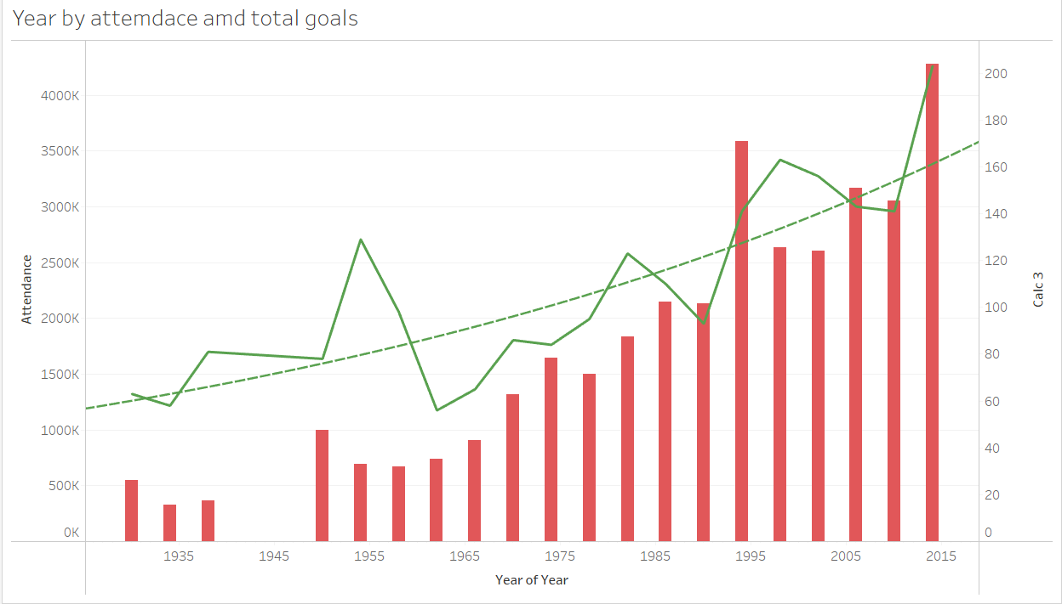
Dual axis graph
A dual axis graph shows the relationship between a dimensional quantity and two measurable quantity
The graph shown shows the relationship between years ,attendance and total goals
We can see that one of the y-axis indicates the attendance by which the bars are made and the other y-axis shows the goals by which the line is made
This shows the yearly growth in attendance
For the line a parameter is given on the basis of which the line varies as the sum of home team goal ,away and total goals
A trend line is also given to show the overall growth

Slide 12
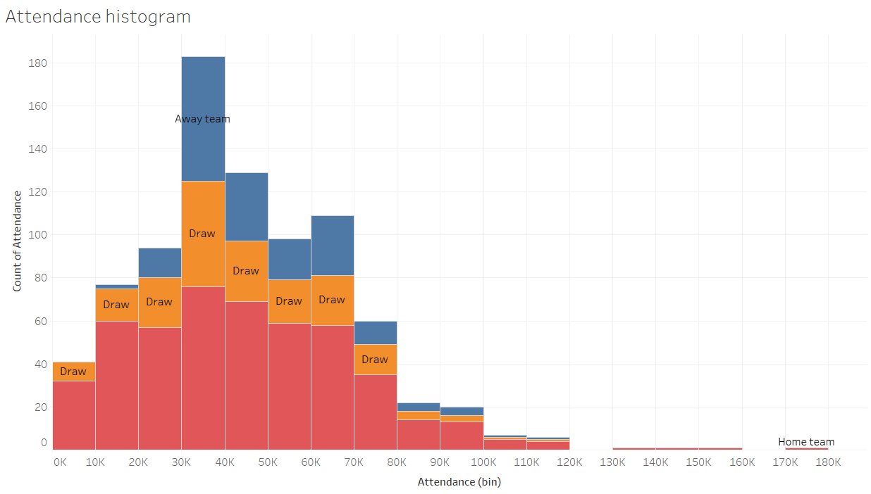
Histogram
A histogram is a type of chart that shows the frequency of distribution if data points across a continuous range
The histogram here shows what frequency of attendance has repeated maximus times . From the graph we can see 30K-40K people has arrived most time
The colour formatting is dome on the basis of the winning team

Slide 13
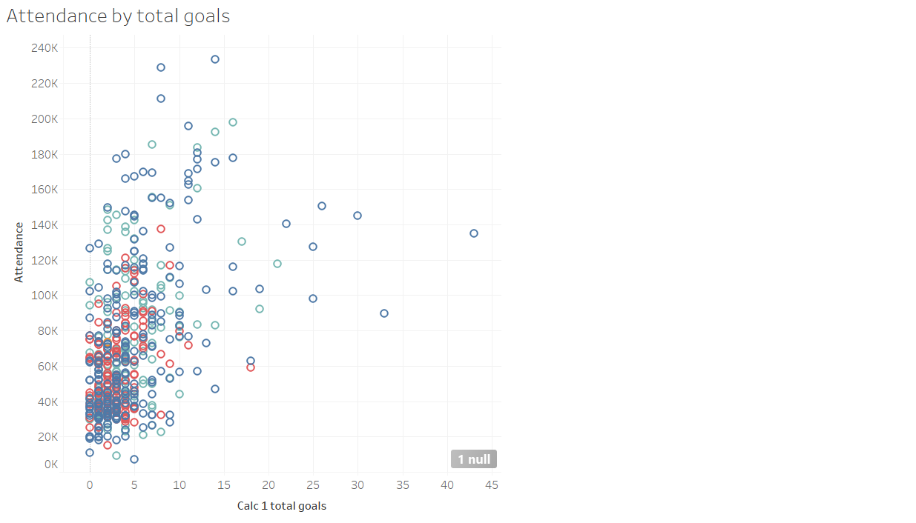
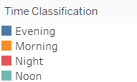
Scatter plot
A scatter plat shows the relationship between two measurable quantities.
The shown scatter plot represent the relationship between attendance and total goals. Hence we can say most matches have goals between 0-5 and the audience between 20K-40K
Also the colour formatting is done on the basis of time classification
Hence most number of matches were played in evening

Slide 14
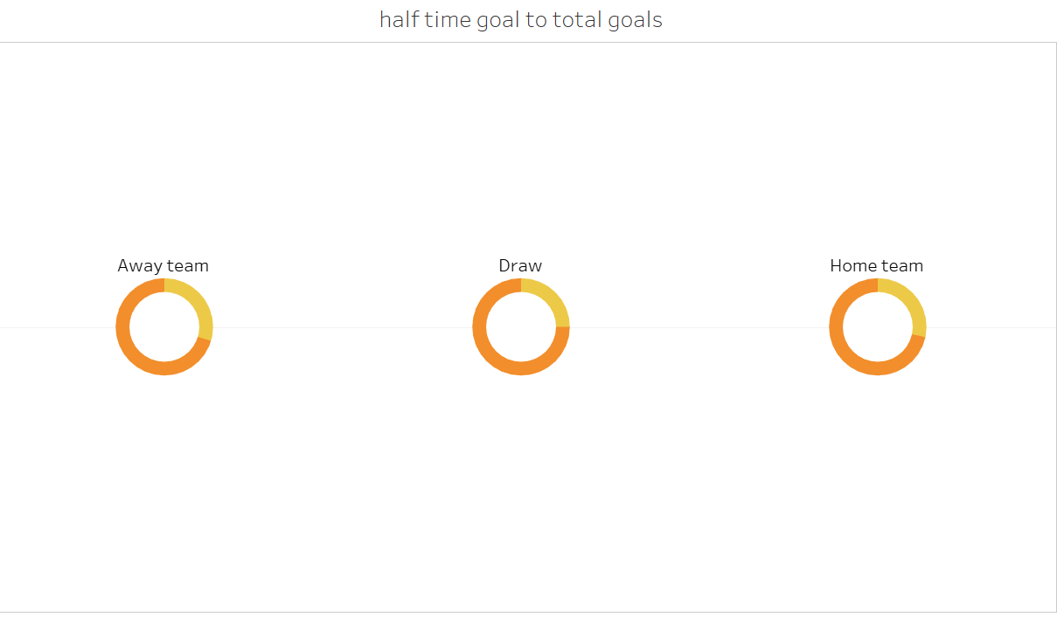
Donut chart
A donut chart is used for composition analysis
In tableau a donut chart is not available
The donut chart shown here is made by combining two pie charts
There chart represent the half time home team goals to the total goals of home team
From there charts we can say a team always plays better in the second half

Slide 15
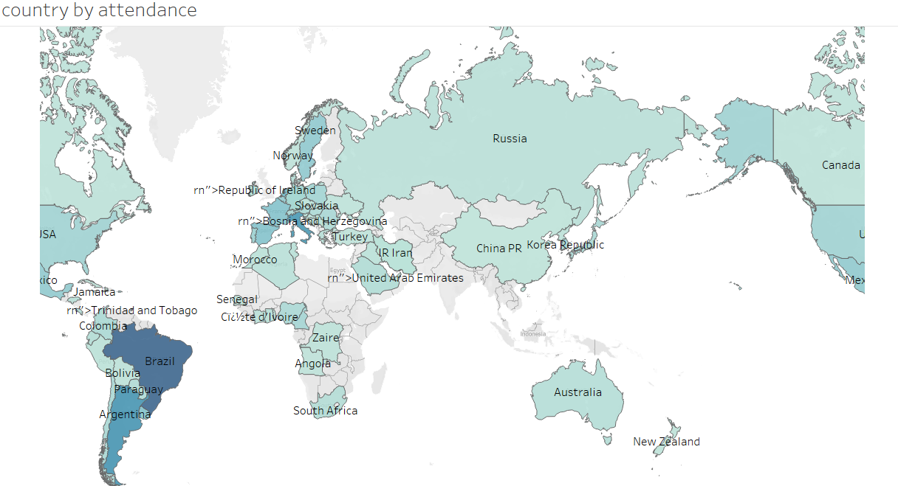
Filled map
A filled map is used for graphical analysis . It is also called choropleth.
The graph shown here shows the country vice attendance
From here we can say that Brazil has the most number of football watchers

Slide 16

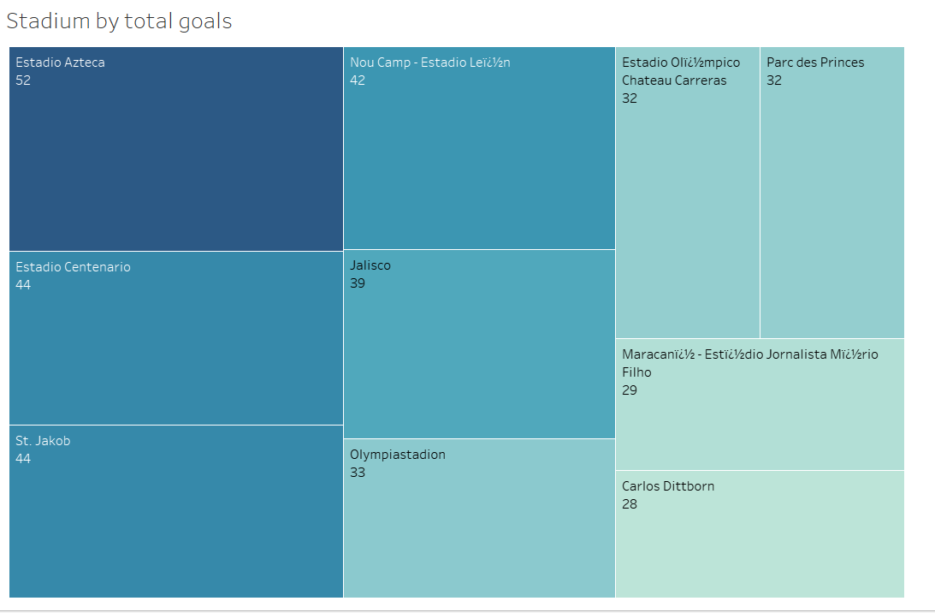
Tree map
A tree map shows the relationship between a dimensional and a measurable quantity
Here the tree map shows in which stadium most number of goals were made
This can be a beneficial information as watching matches in there stadium can be very delightful for the audience
A parameter is also given to adjust the number of stadiums to be displayed

Slide 17
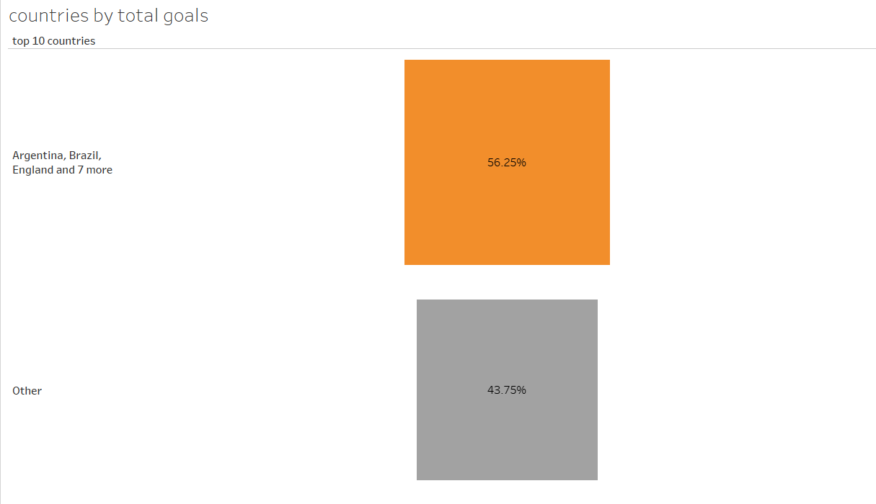
Heat map
A heat map shows the relationship between two quantities on the basis of size
Our data has a total of 78 countries
In the shown heat map a group of the top 10 performing countries is made . And the other 68 countries are placed in other group .
This shows the total goals made by the top 10 countries is grater than the rest 68 countries

Slide 18
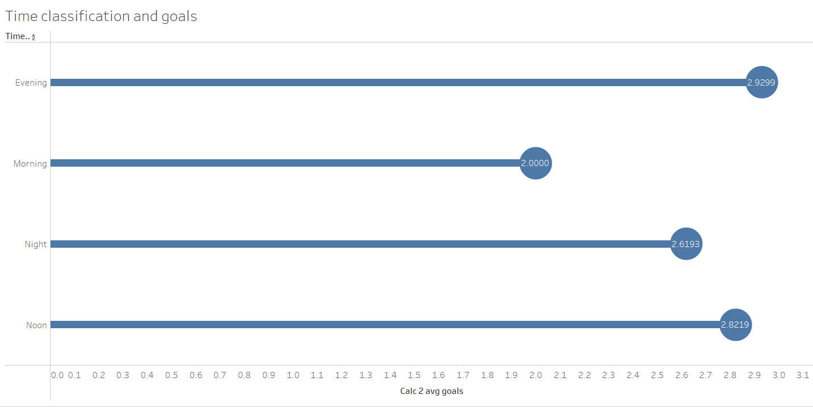
Lollipop chart
A lollipop chart is a variation of bar graph where data points are represented as circles on horizontal or vertical axis
Lollipop chart is not available in tableau
The chart here is created by mixing two charts
Here the chart represents the time classification and the total number of goals scored
Hence the maximum number of goals are scored in evening

Slide 19
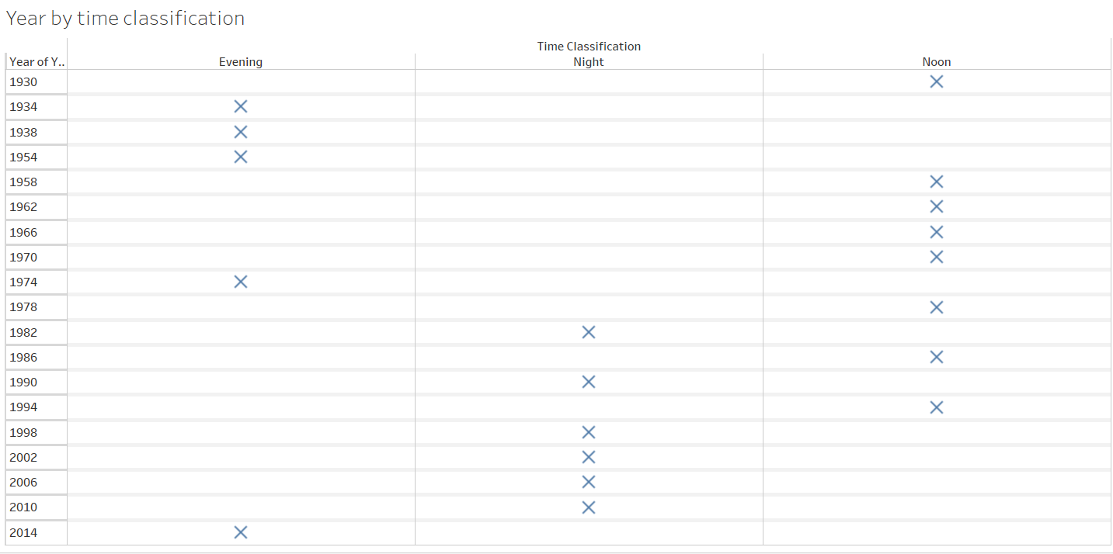
Text table
Many times while representing the values through charts same data gets lost hence some times the use of text table is done
The table here represents year vice at what time the finals are played
The finals are played most in noon but with the passing years it is being shifted to noon

Slide 20
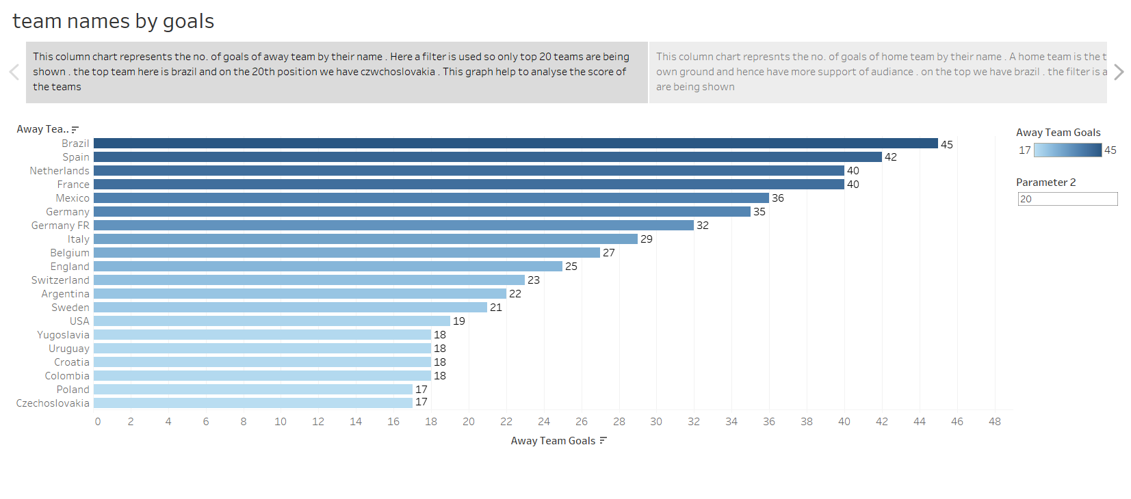
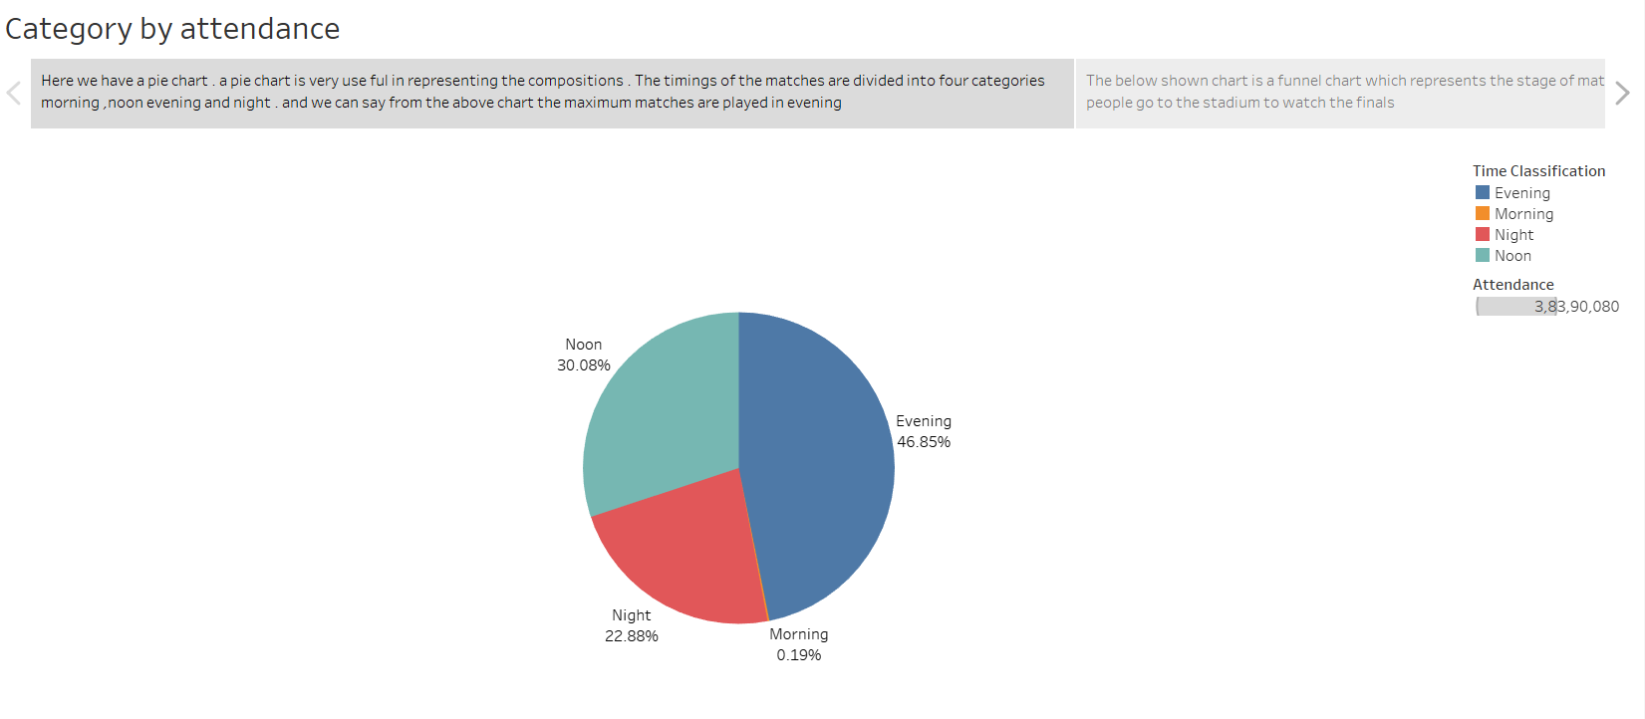
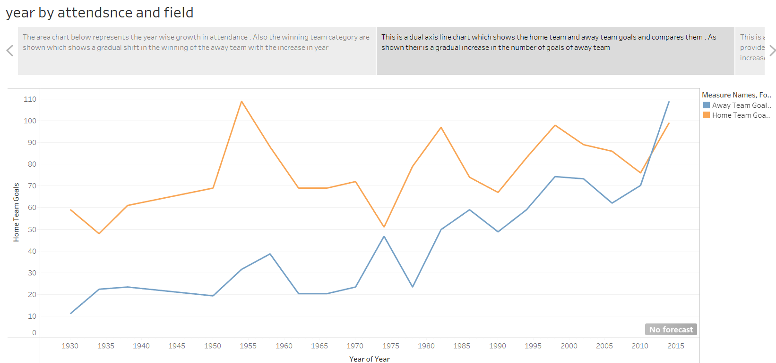
Story telling
In tableau many times complicated charts are made which may be a little difficult to understand hence for the comfort of users a story telling option is given to explain the charts that are made

Slide 21
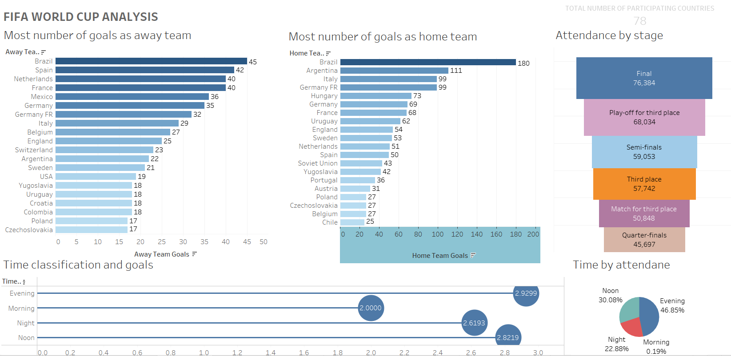
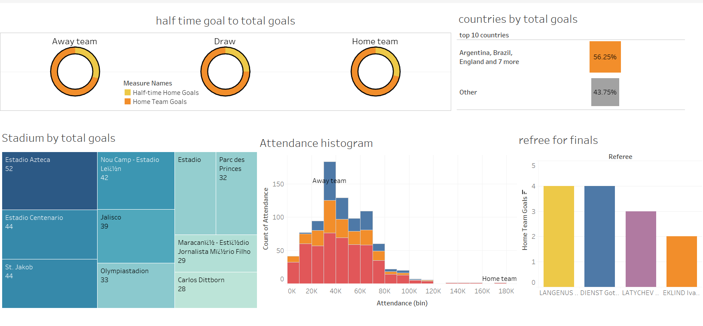
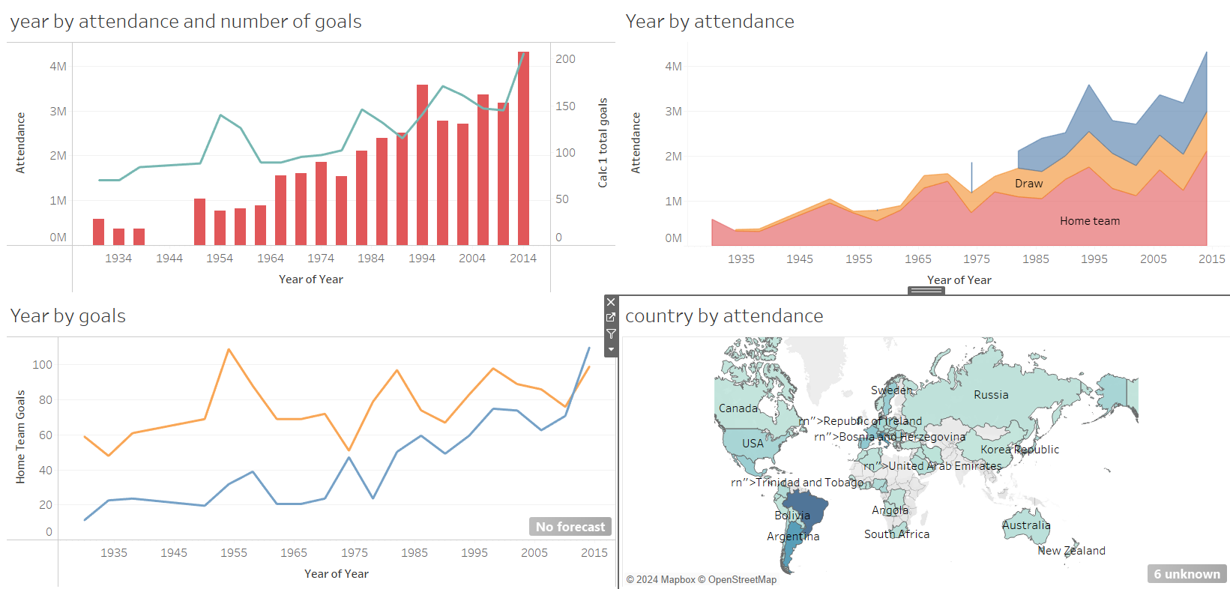
dashboard
To combine all the sheets we have made we use a dash board so that all the information is available to us at a single place

Slide 22
Excel statistics
If we have a large data preforming statistics on it is crucial
By analysing the data statistically we can observe the patters ,trends and relationship with in the data that may not be obvious at first glance
It helps us draw meaningful conclusions ,make prediction , and understand the significance of data

Slide 23
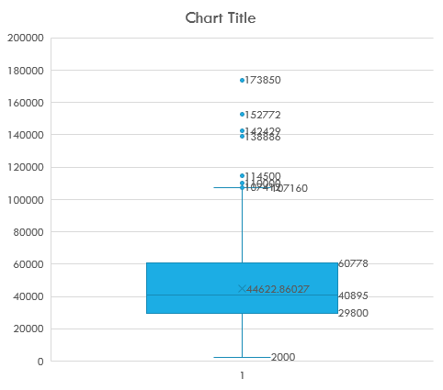
Box and whisker
It is a graphical representation of numerical data through quartiles.
It shows the distribution of data and help identify outliners.
The box plot here shows the quartiles of the attendance of the people who attended the match over the years
The most number of repeated attendance is between 29800-60778
And the maximum attendance is 173850

Slide 24
Linear regression
It allows us to analyse the relationship between two variable fitting a linear equation
The linear equation is in the form of y=mx+b
The chart here shows the relationship between attendance and years
It consist of three values correlation, slope and intercept

Slide 25
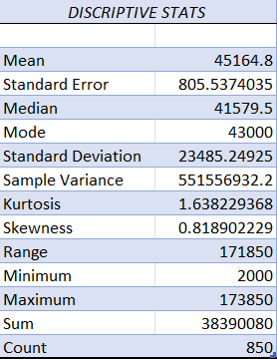
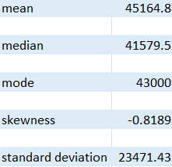
Descriptive STATISTICS
Descriptive statistics help us summarizing and describing the features of dataset
It can be done either by using the summary option or individual formula can be applied
The given is the summary of attendance of the matches over years
It has various field like mean , median, mode standard deviation , skewness etc.

Slide 26
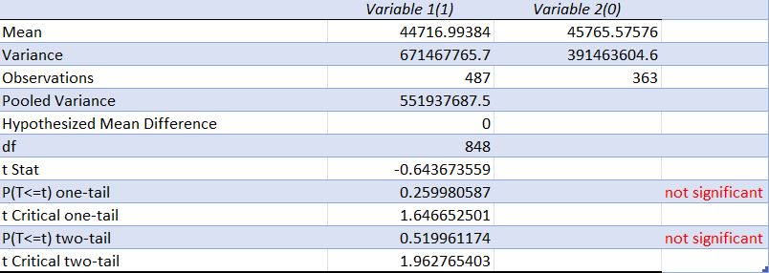
T-test
A t test is a statical test used to determine if there is a significant difference between the means of the two groups
The t test here shows the means of attendance when the winning team is home team and when the winning team is not the home team
1-home team 2-not home team
The t test is considered significant growth only when the p-value is grater than 0.05

Slide 27
forecasting
The excel allows us to predict the future based on the present records
It has a upper confidence bound , lower confidence bound and a forecast
The upper confidence bound shows the maximum value a field can attain and the lower confidence bound shows the minimum value a field can attain
The forecast here shows the growth of attendance per year and the same of the upcoming years

Slide 28
Thank you

